Slide 1


Basic Details of the Team and Problem Statement
Ministry/Organization Name : Ministry of Commerce and Industries
PS Code: SIH1360
Problem Statement Title: Price Comparison of GeM Product with other e-marketplaces
Team Name: Solution@Makers
Team Leader Name: Kanishka Singhal. Institute Code (AISHE): C-46141
Institute Name: ABES Institute of Technology , Ghaziabad.
Theme Name: Smart Automation

Slide 2
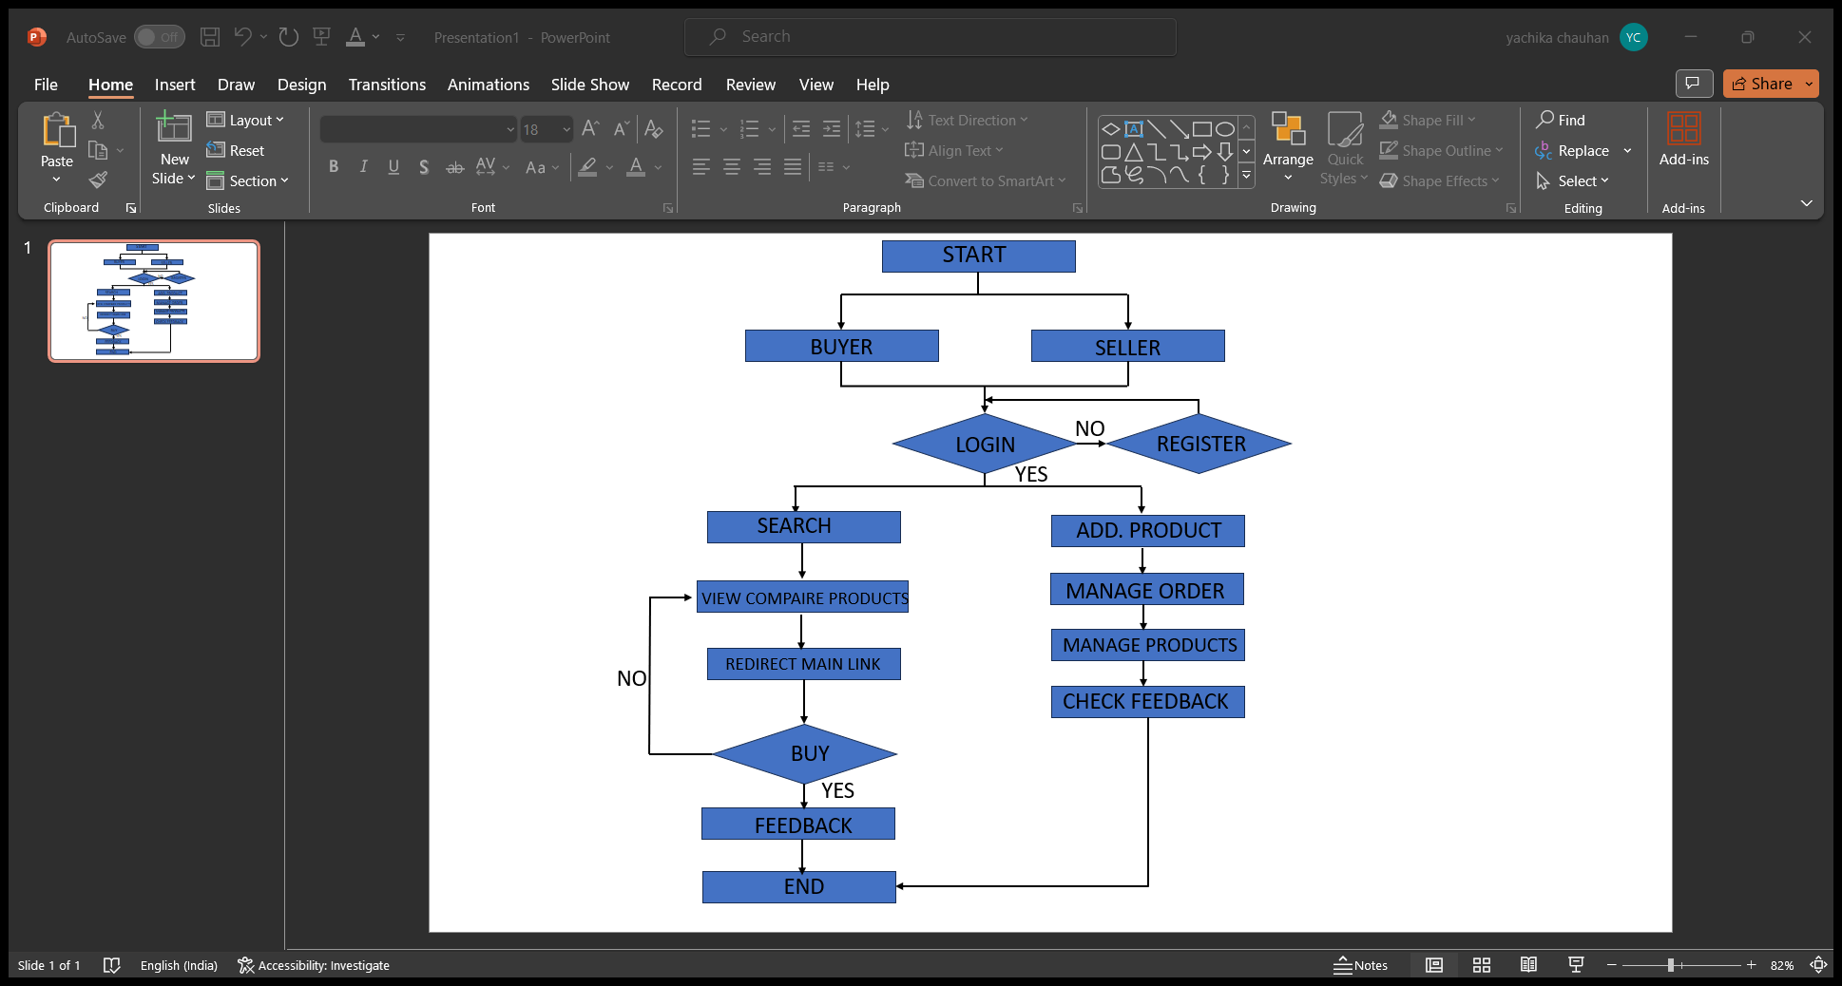
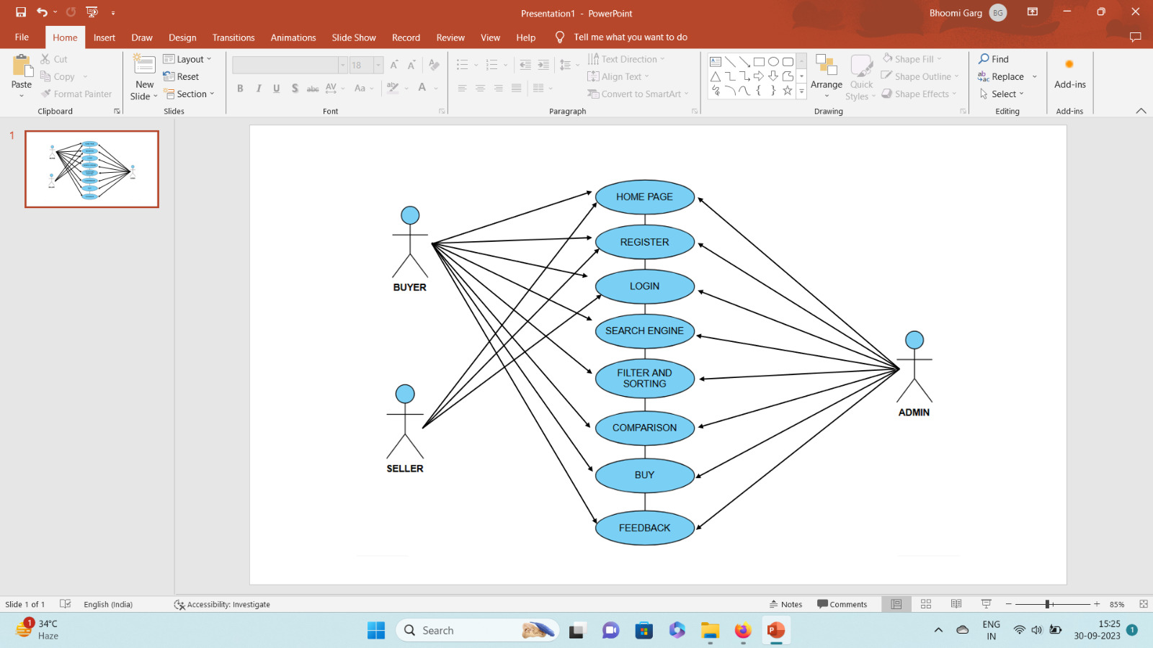






Idea/Approach Details
Working process through flowchart:
The project involves creating a web-based application to compare GeM (Government e-Marketplace) product prices with other e-Marketplaces, aiming to ensure fair and competitive pricing for buyers.
Use case diagram for price comparison:
.
Describe your Technology stack here:

Slide 3
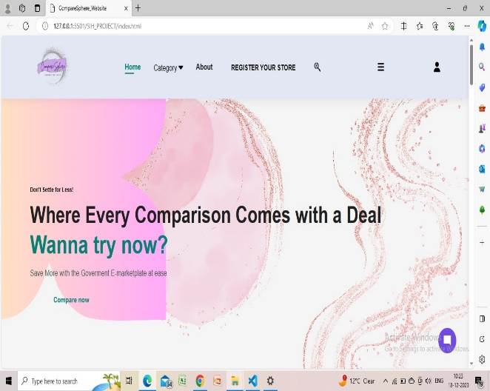
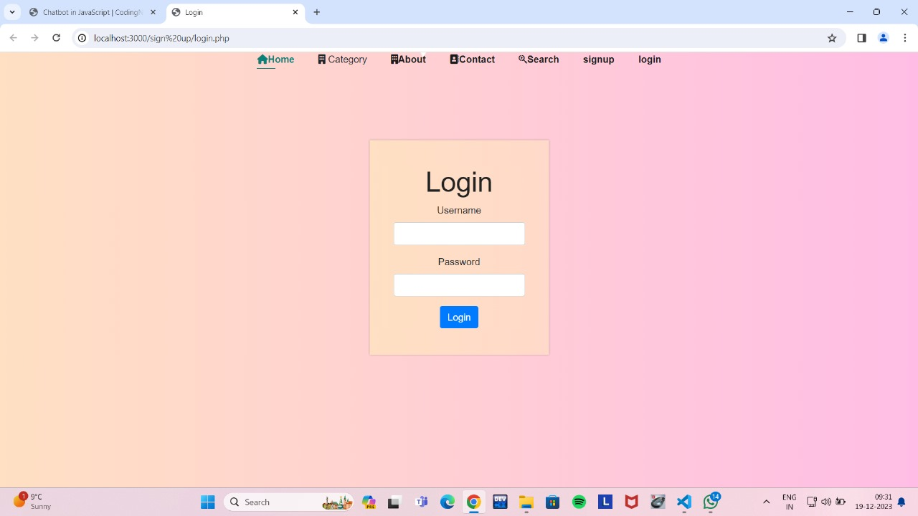
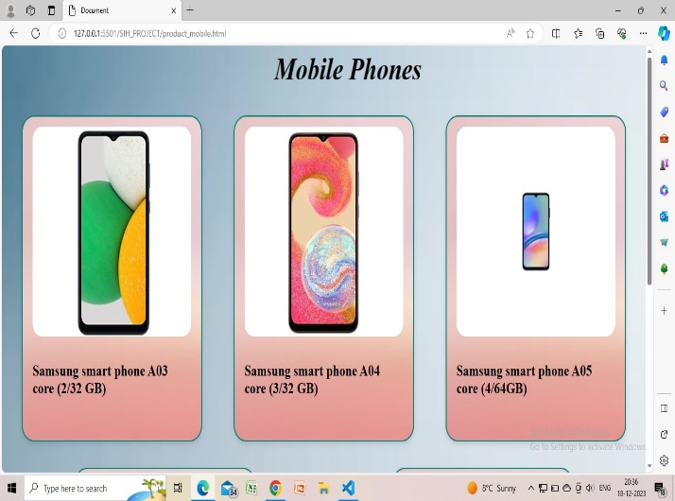
Idea/Approach Details
Describe your Dependencies /Show stopper here:
Mind Map:
SEARCH FUNCTIONALITY
PRICE COMPARISON
USER REVIEWS AND RATINGS
SUPPORT SYSTEM
PRODUCT LISTING
SEARCH
AND COMPARISON
PRECONDITION (REQUIREMENT ADDED)
POST CONDITION (REQUIREMENT MET)
REFINING PATH
ASSUMPTION FOR UPTO DATE DATA
Prototype Preview:
3

Slide 4
Team Member Details
Team Leader Name: KANISHKA SINGHAL
Branch : Btech | Stream : CSE-DS | Year : II
Team Member 1 Name: NIKITA Branch : Btech | Stream : CSE-IOT | Year : II
Team Member 2 Name: KUSHAGRA DUBEY Branch : Btech Stream : CSE Team Member 3 Name: NAHIM AHMAD
Branch : Btech Stream : CSE-IOT
Team Member 4 Name: BHOOMI GARG
Year : II
Year : II
Branch : Btech | Stream :CSE-IOT | Year : II
Team Member 5 Name: YACHIKA Branch : Btech | Stream : CSE-AI | Year : II
Team Mentor 1 Name: Type Your Name Here Category (Academic/Industry): |  | Expertise (AI/ML/Blockchain etc): | Domain Experience (in years):
Team Mentor 2 Name: Type Your Name Here
Category (Academic/Industry): |  | Expertise (AI/ML/Blockchain etc): | Domain Experience (in years):

